Slide 1

React CRUD
React 4

Slide 2

Outline Kelas
1
CRUD - (Create, Read, Update, Delete)
2
Integrasi API

Slide 3
Apa itu CRUD
CRUD
Create
Delete
Read
Update
four basic operations of persistent storage

Slide 4
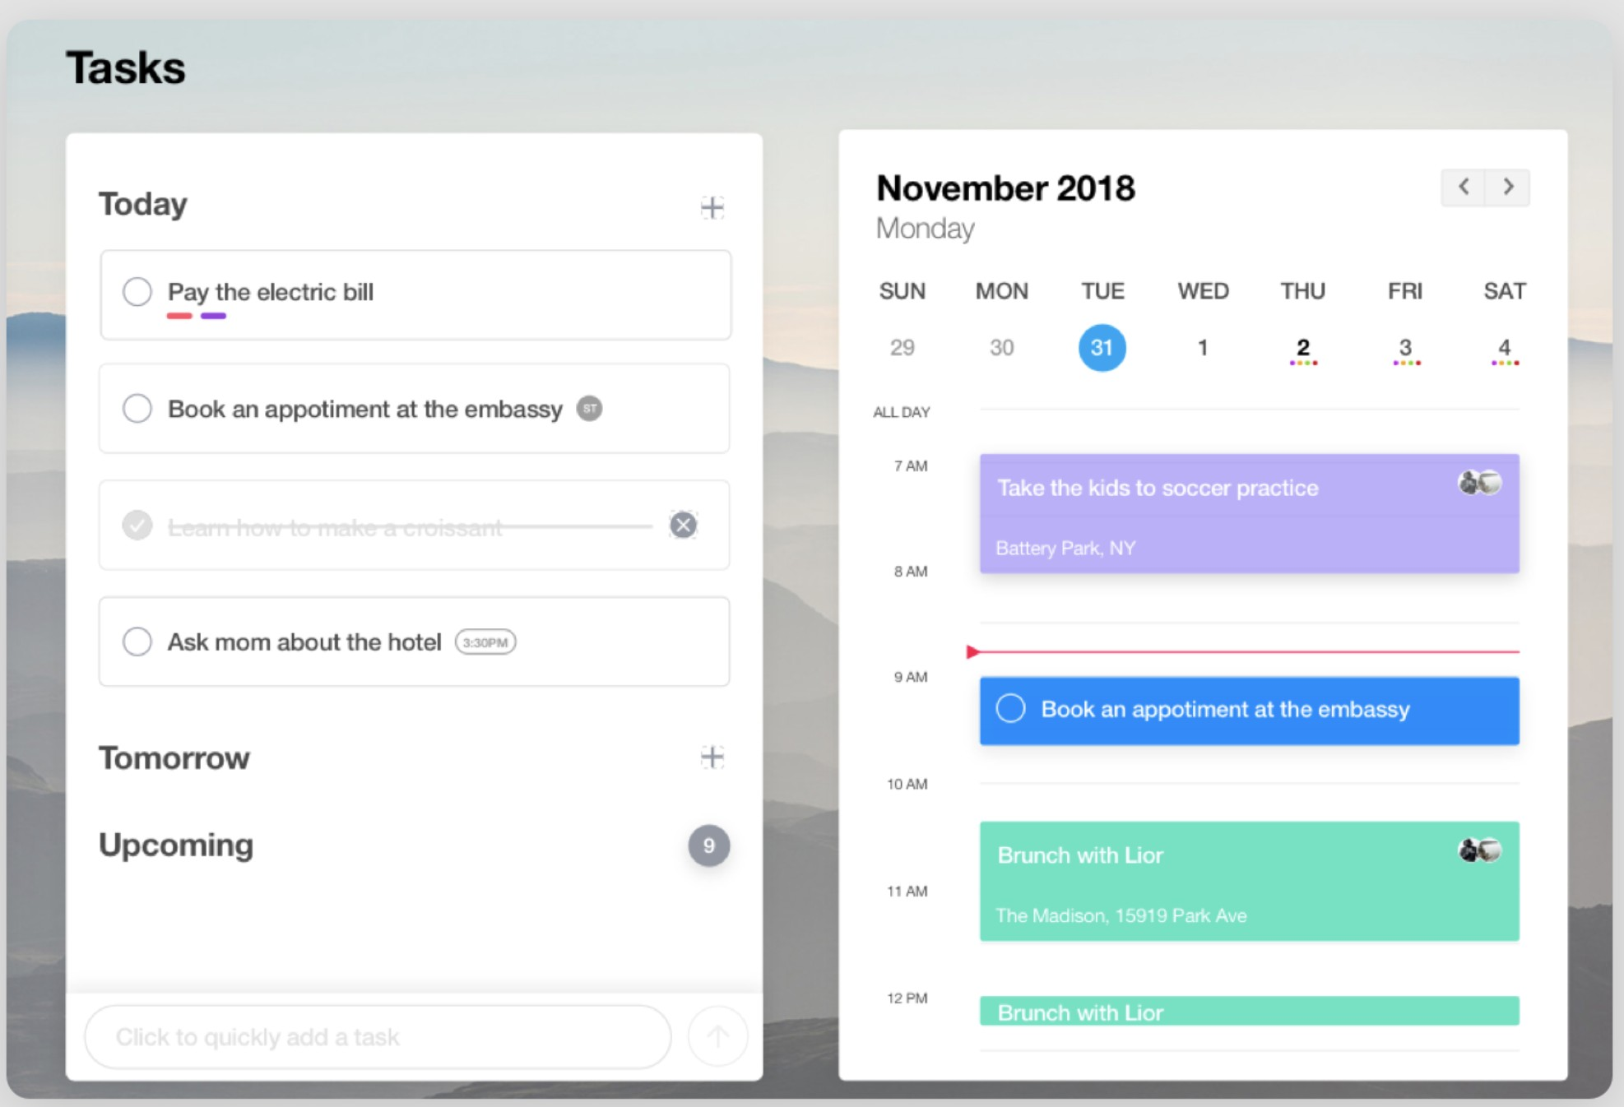
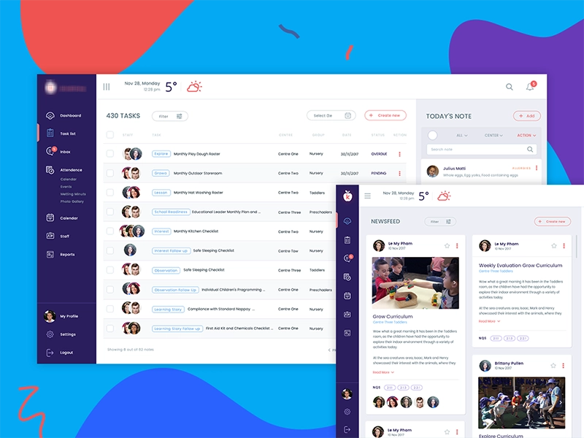
Contoh aplikasi CRUD
Todo List
Admin System

Slide 5
Membuat Layout Aplikasi CRUD
sederhana

Slide 6
Hands On Coding..

Slide 7
TODO LIST
CREATE INSERT NEW EMPLOYEE FORM
INPUT NAME
INPUT AGE
SUBMIT BUTTON
[Exercise] CREATE LIST ITEM COMPONENT
EMPLOYEE ID, NAME, AGE
EDIT BUTTON
DELETE BUTTON
CREATE EDIT CONFIRMATION
[Exercise] CREATE DELETE CONFIRMATION

Slide 8
Fake Backend
di directory pada command prompt
git clone https://github.com/priambudiLB/fake-api.git cd fake-api
git fetch origin v1.0 git checkout v1.0
npm i (tunggu proses instalasi node_modules) npm start
backend akan running di port: 7777

Slide 9
List endpoint
GET /employee
GET /employee/:id
POST /employee
name
age
PUT /employee/:id
name
age
POST /employee/delete/:id

Slide 10
// Send a POST request axios({
method: 'post',
url: 'http://localhost:7777/employee', data: {
name: 'Bagas', age: 1
}
});
// GET request axios({
method: 'get',
url: 'http://localhost:7777/employee',
})
.then(function (response) {
...
});

Slide 11
Axios Instance methods
GET POST PUT
DEL
axios.get(url[, config])
axios.post(url[, data[, config]])
axios.put(url[, data[, config]])
axios.delete(url[, config])

Slide 12
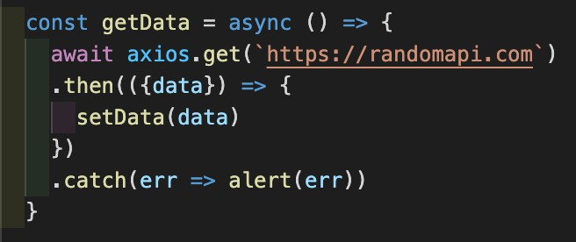
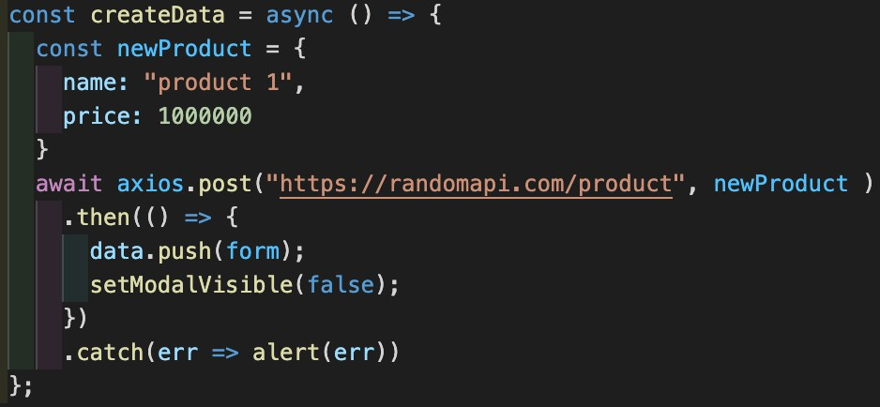
Contoh Implementasi axios

Slide 13
Thank you

